Slide 1
Classification Problem Learn Python and Learn Programming Subreddit
Ling Chong Gold

Slide 2
Agenda
Background
Problem Statement
Obtaining Data and Cleaning Data
Exploring Data
Feature Engineering
Modelling
Comparing Top 2 Model
Model Selection
Evaluating Model
Conclusion

Slide 3
Background
Reddit is a forum consisting different subreddits
Each subreddits are of a topic of interest
Users can participate in subreddits which interests them
Amongst the subreddits there are overlapping topics
There are also posts which could be placed in more relevant subreddits

Slide 4
Problem Statement
Business Problem:
We have quite a number of overlapping subreddits. How can we ensure that posts in the subreddits are in the right place?
Data Science Problem
Use Natural Language Processing
Identify 2 overlapping subreddits with adequate text
Create classification models to classify posts to their respective subreddit
Evaluate the models and select the best model to answer the business problem

Slide 5
Obtaining Data and Cleaning Data
Subreddit Learn Python and Learn Programming was selected
Data from both subreddit was scraped using the Requests library
Column selftext which contains the content of the posts is determined to contain features which will answer our problem
Data was cleansed using the following libraries
BeautifulSoup
NLTK (Stopwords)
Regex
Python’s string manipulation
Notes:
Other columns like title, number of comments, author could also assist in this problem, however we will focus on selftext first
Data Cleasing
Beautiful soup to remove html codes
nltk stopwords used to remove common words like ‘I’, ‘you’, ‘and’ etc
Regex to remove website links and remove punctuation

Slide 6
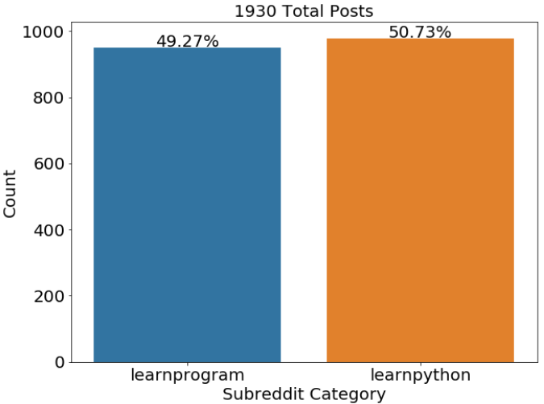
Exploring Data
After Obtaining and Cleaning Data
We have a total of 1930 posts
A good ratio between the 2 subreddits
Baseline Accuracy of 50.73%
Notes:
The baseline accuracy for a classification problem is the normalised value count of the higher class.

Slide 7
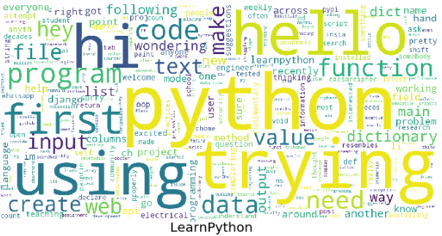
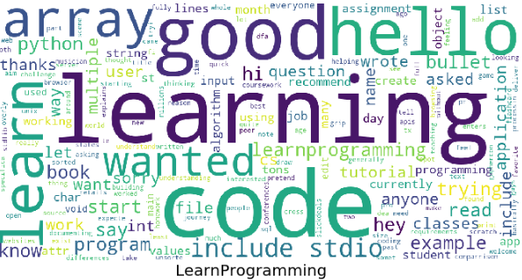
Exploring Data
“hello” and “code” are some common words which appears frequently in both subreddits
We can explore more on such words and put them in a customized stop words
Notes:
Due to topic chosen we can expect to see many common words to appear in both subreddit
learn python can be considered a subset of learn programming

Slide 8
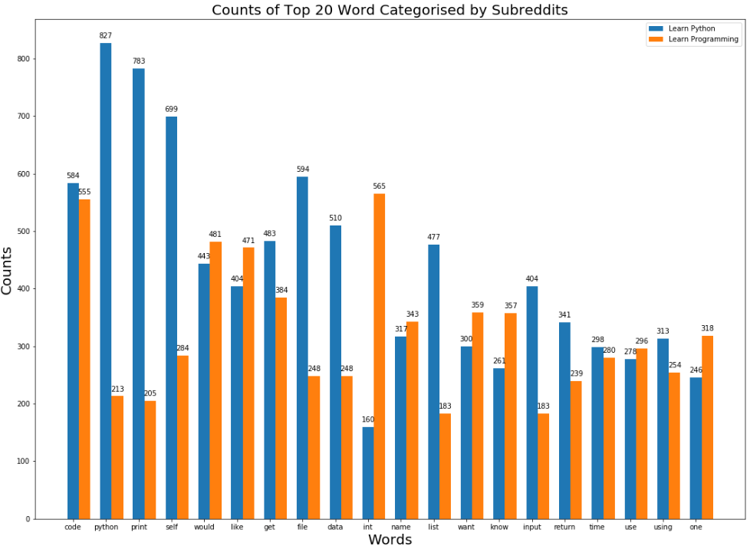
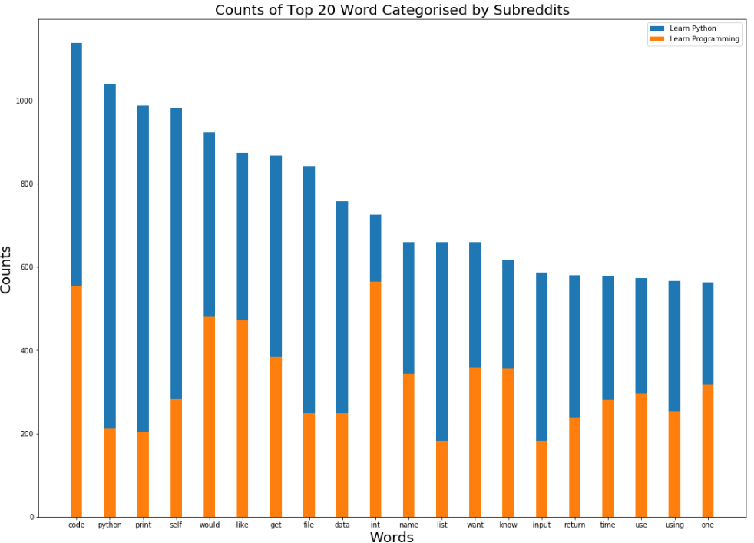
Exploring Data
Top 20 words appearing in the corpus
Code is a common word at both subreddit
Python appeared in both but more in learn python
Words like code should be included in our customized stopwords
Notes:
Code appeared in learn python 584 times and in learn programming 555 times. This is one word which we may wish to include in our customized stopwords
Pyton appeared in learn python 827 times, and in learn programming 213 times. This word appear significant more in learn python, this word could be a good feature and should be excluded in our customized stopwords

Slide 9
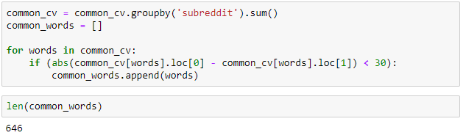
Feature Engineering
Lemmatizing
Reduce words to their root keeping its context e.g. better → good
Stemming
Removes suffixes and prefixes and may lose context e.g. care → car
Customized Stopwords
Notes:
Stemming context in this use case is not relevant as we are performing word classification belonging to which subreddit
Lemma was the best to use after 2 tests were ran
Customised stopwords
Absolute value of difference in the count of word appearing each subreddit and include them in should it be less than 30

Slide 10
Modelling
4 Models Was Built
Model 1 - Count Vectorizer with Naive Bayesian's MultinomialNB
Model 2 - Tfidf Vectorizer with Naive Bayesian's MultinomialNB
Model 3 - Count Vectorizer with Logistics Regression
Model 4 - Tfidf Vectorizer with Logistics Regression
Model 2 and Model 3 were overfitted
We will take a closer look into Model 1 and Model 4
Notes:
Multinomial is selected instead of Bournalli and Gaussian of Naive Bayesian's model is because our features are all integer counts.
Bernoulli will be better when we have 0 or 1 in all of our features(dummies)
Gaussian is better when our features are Normally distributed.
Among all four models, model 2 and model 3 are overfitted. We will take a closer look at model 1 and model 4

Slide 11




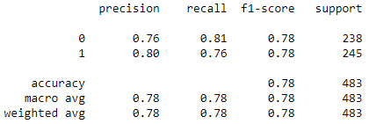
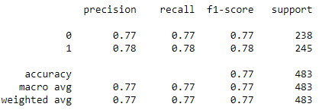
Comparing Model 1 and Model 4
Model 1
Model 4
Model 4 has a higher mean score between train and test
Model 1 has higher precision
Notes:
Model 1 mean score is 0.7758
Model 4 mean score is 0.7797
Model 1 precision is 0.80
Model 4 precision is 0.78
Precision formula = True Positive / True Positive + False Positive

Slide 12
Model Selection
We are looking to classify a post and move them to the correct subreddit.
A post from learn python appearing in learn programming subreddit is reasonable as python is a programming language while the vice versa is not
From this, we can see that the cost of false positive is higher than the cost of false negative.
When the cost of false positive is high, precision is a good metrics to follow
Notes:
Recall the business problem
Point 3 - We wrongly classify a post to be python and move it to python (it should be learn programming)
False Negative = We wrongly classify it to be learn programming and move it to learn programming (it should be learn python)
Precision formula = True Positive / True Positive + False Positive

Slide 13
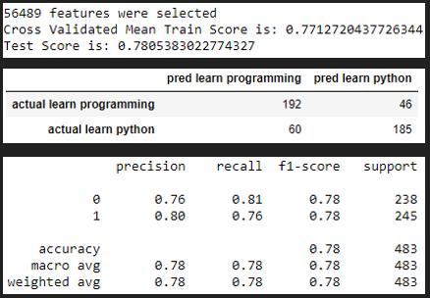
Evaluating - Model 1
192 posts predicted to be from learn programming are from learn programming
46 posts predicted to be from learn python are from learn programming
60 posts predicted to be from learn programming are from learn python
185 posts predicted to be from learn python are indeed from learn python
This model's precision is 80% and the recall is 76%.
Notes:
192 True Negative
46 False Positive
60 False Negative
185 True Positive
Precision formula = True Positive / True Positive + False Positive
Recall formula = True Positive / True Positive + False Negative

Slide 14
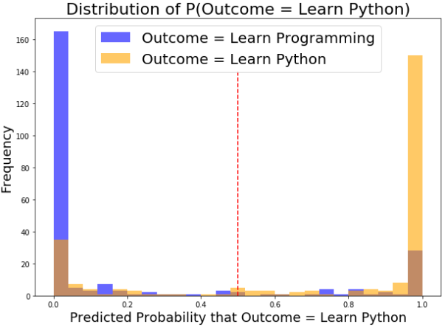
Evaluating - Model 1
Predicted probabilities distribution
Bimodal distribution
Misclassifications
Blues appearing at the right of the red line
Orange appearing at the left of the red line
Notes:
2 peaks at the end, a characteristic of a bimodal distribution
This is the right distribution as we are classifying between 2 distinct classes
Perfect model will be where all the blue is to the left and all the orange is to the right

Slide 15
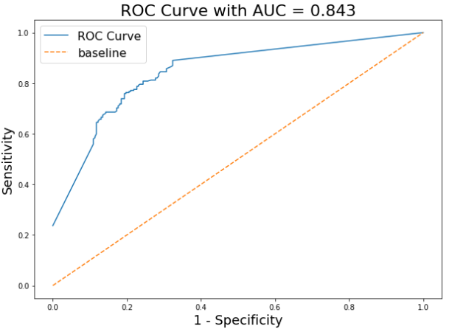
Evaluating - Model 1
A good model’s ROC AUC is above 0.5 and close to 1
A ROC AUC of 0.5, that means that our positive and negative population overlaps perfectly, inferring that the model is bad
If the ROC AUC is below 0.5, it means that our model inversely classified the observations
Our ROC AUC is 0.843

Slide 16
Conclusion and Recommendation
A model with the lower score was selected as it answers the business needs
For this instance a higher precision and lower false positive
Business can use this model and move posts for the 2 subreddits
With lesser overlapping posts we can then run the next iteration and determine if the model improves
We can perform an analysis on the title, number of comments and author to see if these are good features to be included for the next iteration
We can explore auto-tagging or subreddit recommender system with improved model
Notes:
It is not always the model with the best score is the best model
First 3 points are actions that can be taken now
Remaining 3 points are for future improvememts

